Slide 1

Zero Hour Emergency UAV
Final Review
Guided By:
Mr. K . Gerard Joe Nigel
Robotics and Automation
Presented by
Kanagarajan M - PRK20RA1005
Robotics and Automation

Slide 2
Problem Statement
Many rural peoples lost their life due to improper first aid at the time of emergency.
Many people in cities lost their life in emergency case due to traffic or not reaching hospital on time.

Slide 3
Objective
The goal of our project, the air ambulance comes to the rescue situation, equipped with first aid and basic surgical kit. The air ambulance can reach the accident area within minutes and deploy necessary emergency supply

Slide 4
CONSTRUCTION
The main components are used in hexacopter drone is as Follows
1) Frame :-HJ550mm Plastic Fiber Frame
2) Motors : Six 1000KV BLDC motors
3) Electronic speed controller(ESC): 30amp Simon
4) Flight Controller :Picxhawak flight controller
5) Battery :5200mAH Lipo
6) GPS module :M7N
7) Transmitter:FSi6 Flysky
8) Receiver:6 channel fsi6
9) Telemetry module :433MH
10) Propeller:10*4.5
11) Raspberry Pi 3 b+
12 ) Tft control

Slide 5
HEXACOPTER DESIGN
It is implementation of Quad copter for more stability and strength. The use of drone as air ambulance. For this reason , the first step is to develop a hexacopter
Both the torque and thrust are produced by every hexacopter and it is produced about its COR (center of rotation). In addition to this a drag force is also produced in opposite direction to its Flights. Every hexacopter
This way, the propellers fixed on the motors can be used for the flight of the hexacopter in all direction.

Slide 6
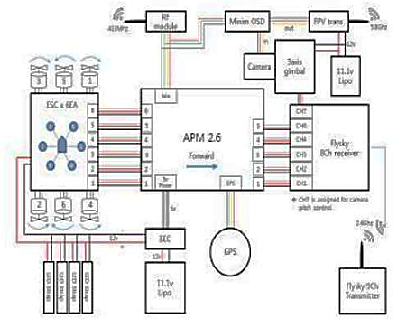
Block Diagram

Slide 7
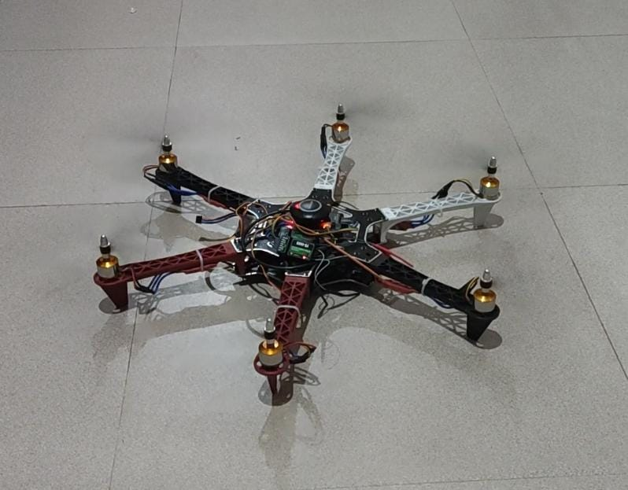

Slide 8
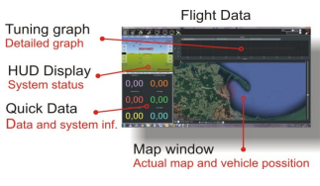
Mission planner

Slide 9
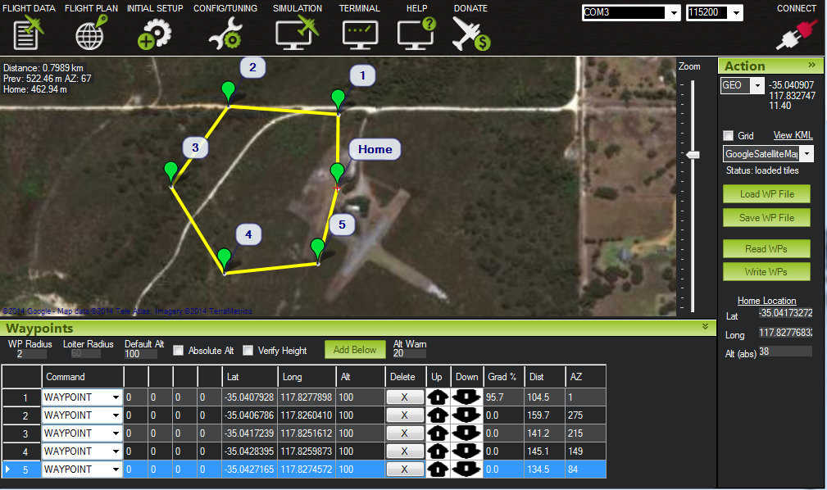
GPS Automation

Slide 10
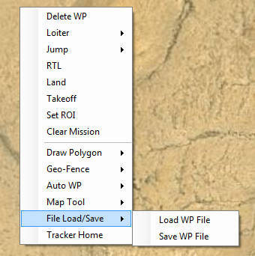

Slide 11
Zero Hour UAV Communication.
Here Once the UAV reaches the specified location or Accident spot or the given latitude and longitude co-ordinates, Now the code in Raspberry Pi starts to run, Here the latitude and longitude co-ordinates are feed in the raspberry Pi and the hospital list also will be feed in the raspberry Pi ,
Once the raspberry Pi co-ordinates and the Co-ordinate of the drone matches each other ,Now the Interactive voice response process is triggered .
Now this IVR makes a call to the nearby Hospital line by line. If one hospital attends the call of IVR ,Then a sms will be sent to that hospital by using GSM sim card. Here In that SMS the latitude and longitude co-ordinate of the accident spot along with the Google meet link will be sent.
Once the Doctor enters the Google Meet link then he/she can see the accident spot through the live streaming via the web cam available in the Raspberry Pi. Then the doctor can guide/Interact with the Public and suggest the steps that need to be taken as First aid

Slide 12
Interactive Voice Response (IVR)
Interactive Voice Response (IVR) is an automated phone system technology that allows incoming callers to access information via a voice response system of pre recorded messages without having to speak to an agent, as well as to utilize menu options via touch tone keypad selection or speech recognition to have their call routed to specific departments or specialists.

Slide 13
Materials Required
Raspberry Pi (2 or 3 or 4) running latest version of Buster
SIM800L GSM Module
2G SIM Card (Airtel)
Aux Cable
LM2596 Buck Converter Module
USB to TTL Converter
12V 2A Adapter
Perf Board
Berg Sticks
Connecting wires

Slide 14
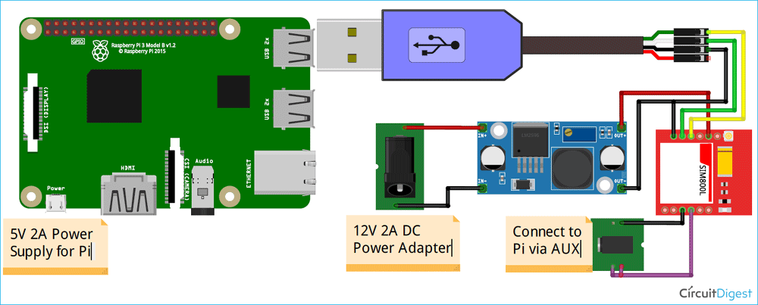


Slide 15
Live streaming in Raspberry Pi
Flask
Web App
Open CV
Live Streaming

Slide 16
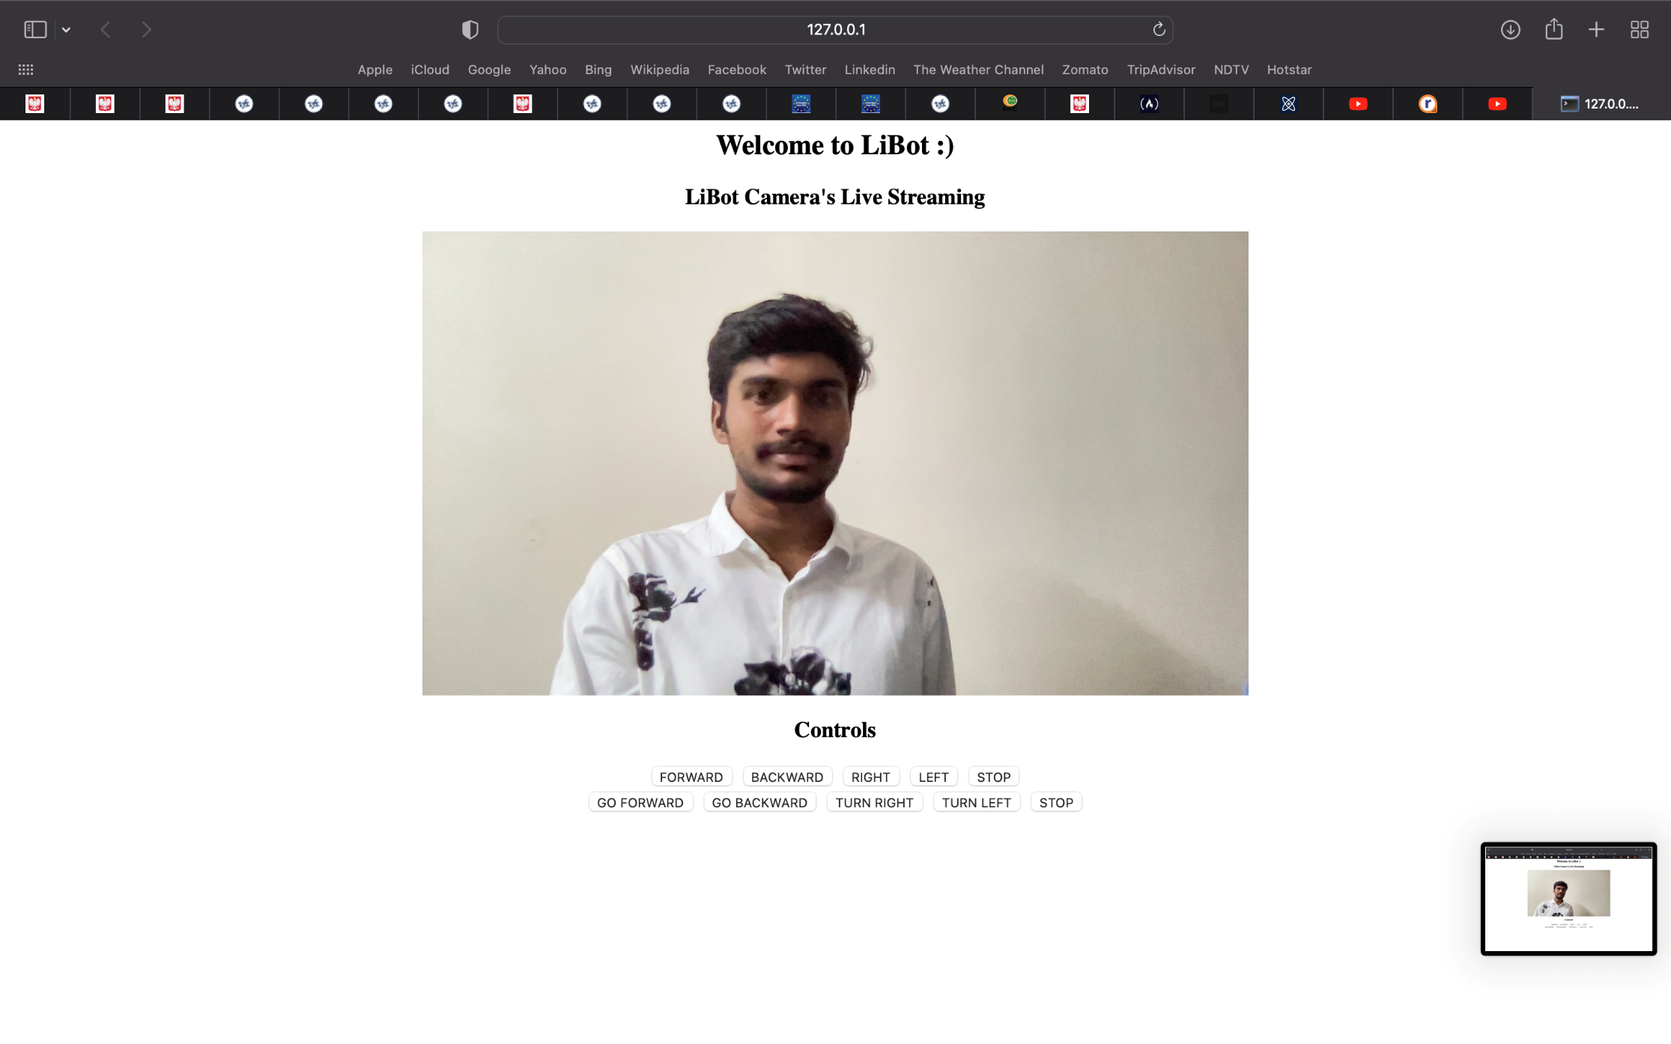
Live streaming Output:
Zero Hour UAV Live Steaming

Slide 17
NEO-6M GPS Module with Raspberry

Slide 18
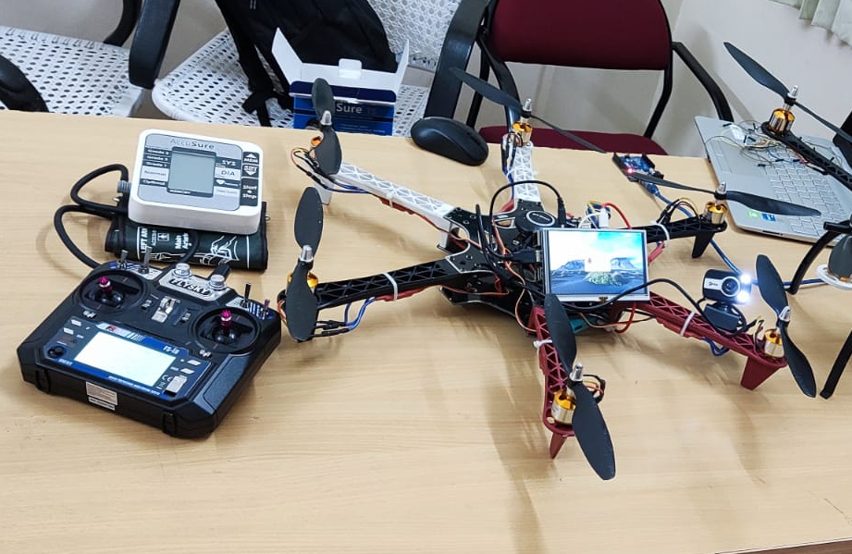
Final Result

